Slide 1



Integration Testing
Course: Software Testing $ Quality Assurance
Student: Kevin Githinji
ID No: 667221
Notes:
1

Slide 2
What is Integration Testing?
Definition
Bridge Phase
Primary Goal
Testing multiple software modules combined as a group to verify they interact correctly and exchange data appropriately.
Acts as a bridge between Unit Testing and System Testing, detecting interface errors early in the development cycle.
To detect issues that arise when modules interact, such as incorrect data flow or failure to handle errors between modules.
Goal
Build confidence that the integrated system will function as intended when deployed in production.
Notes:
2

Slide 3
Key Objectives
1
Data Exchange Verification
2
Early Defect Detection
Ensure modules exchange data correctly and consistently across all interfaces.
Identify and resolve interface-related defects before they reach system testing.
3
Workflow Validation
4
Requirements Compliance
Confirm end-to-end workflows spanning multiple modules function as expected.
Validate that combined modules meet business and functional requirements.
Notes:
3

Slide 4
Why Integration Testing Matters
Prevention Focus
Cost Efficiency
Prevents failures from data format mismatches and interface errors that could crash production systems.
Detects defects early, saving time and cost by avoiding expensive rework in later stages.
Software applications consist of interdependent components. Without integration testing, apps may pass unit tests but fail in production due to interface mismatches.
Notes:
4

Slide 5




Integration Testing Approaches
Big Bang
Top-Down
All modules integrated simultaneously after individual unit testing. The entire system is then tested as a whole. Simple but difficult to debug. Best for small projects.
Integration starts from top-level modules downward. Validates high-level logic early but requires stubs.
Bottom-Up
Sandwich/Hybrid
Begins with lower-level modules moving upward. Tests utilities early but delays high-level validation.
Combines top-down and bottom-up approaches. Balanced but requires complex planning and resources.
Notes:
5

Slide 6




Advanced Integration Strategies
Incremental Integration
Modules integrated one at a time with testing after each addition. Easier debugging but time-consuming.
Feature-Based Integration
Integration based on business features rather than technical hierarchy. Aligns with user acceptance criteria.
Risk-Based Integration
Prioritizes high-risk, complex, or critical modules first. Efficient for resource-constrained projects.
Thread-Based Integration
Modules integrated along end-to-end execution threads representing complete system workflows.
Notes:
6

Slide 7






Interface Testing
Interface Testing focuses on interaction points between modules, ensuring accurate data exchange in distributed systems and API-driven platforms.
Data Transmission
Error Handling
Verify data sent and received correctly between modules
Test graceful failure handling, timeouts, and retries
Boundary Conditions
Performance
Validate minimum/maximum data limits are handled properly
Ensure communication meets speed and scalability requirements
Security
Compatibility
Verify authentication, encryption, and authorization mechanisms
Test interaction with third-party APIs and external services
Notes:
8

Slide 8
Real-World Case Study
Online Shopping System Integration
1
2
3
Add to Cart
Checkout Process
Payment Processing
User adds item to shopping cart module
Cart data transfers to checkout module
Payment module processes via third-party gateway
4
5
Inventory Update
Notification
Inventory module updates stock levels
System sends confirmation email/SMS to user
Notes:
9

Slide 9
Integration Testing Frameworks
Conclusion
JUnit - used in java projects
NUnit - provides assertions and test runners
PyTest - pyhton
Advantages
Detects interface defects early
API and Service Testing Tools
Builds confidence in workflows
Postman
soapUI
Karate DSL
REST Assured
Reduces system testing failures
Simulates real-world scenarios
Limitations
Requires significant resources
UI & Workflow Testing Tools
Complex environment setup
Selenium
Cypress
Katalon studio Appium
Challenging debugging process
Dependency on stubs/drivers
Thank You!
Specialized Testing Tools
FitNesse VectorCAST
Cucumber
Tessy
Notes:
10

Slide 10
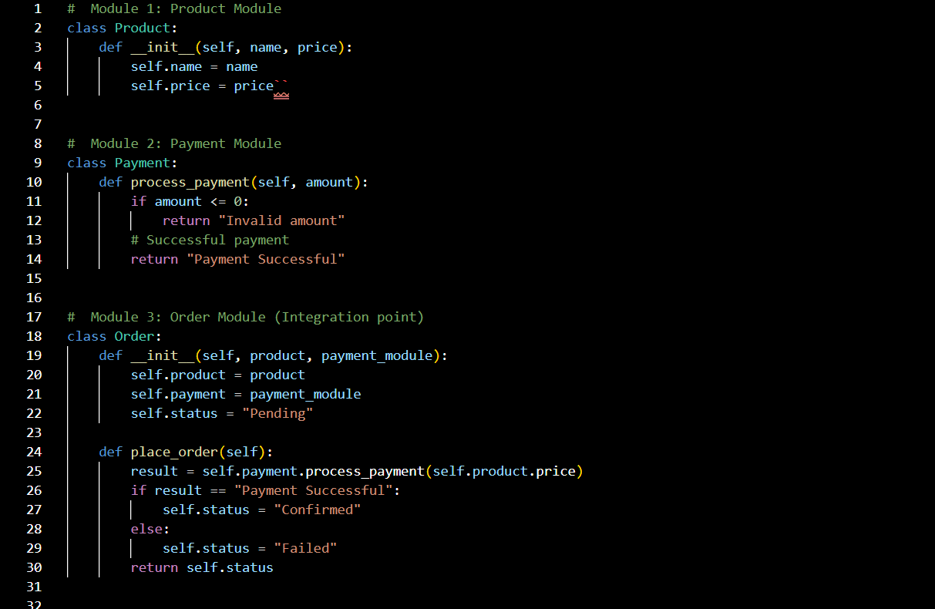

Slide 11
